Slide 1
Technical environmental systems
Energy consumption case study analysis in Open Studio software

Slide 2
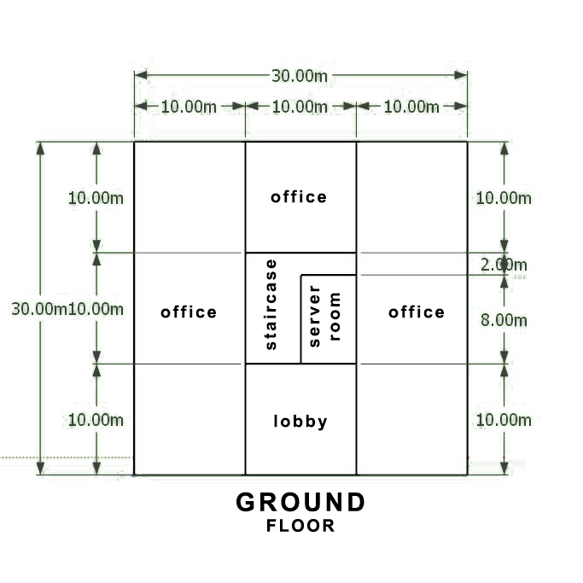
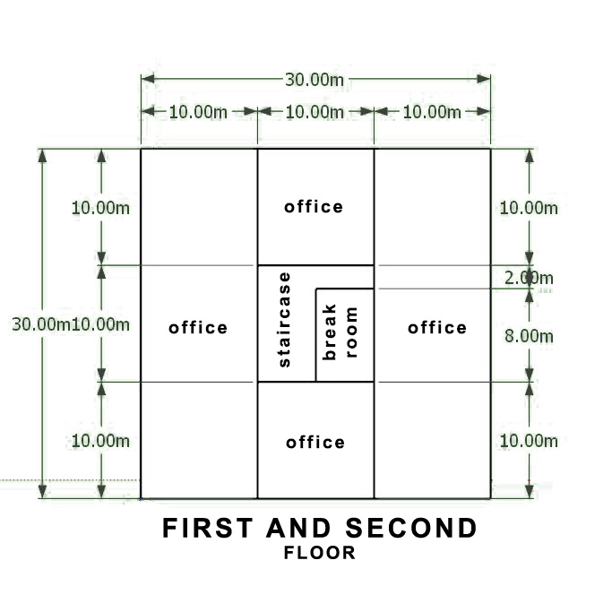
Building analysis introduction: This report focuses on energy consumption analysis of the small office building and the effects of construction and environmental condisions on it. This analysis will be conducted in „Open studio“ software. The analized buildint consists of three floors which have large open office spaces on all sides of the building, with the exeption of the ground floor that houses a lobby on the south side. In the central core there are main vertical connections as well as the break and server rooms, as seen in the plans below. All sides of the building have 40% of the walls in windows and with the exeption of the north also have shading devices.
FIGURE 1

Slide 3
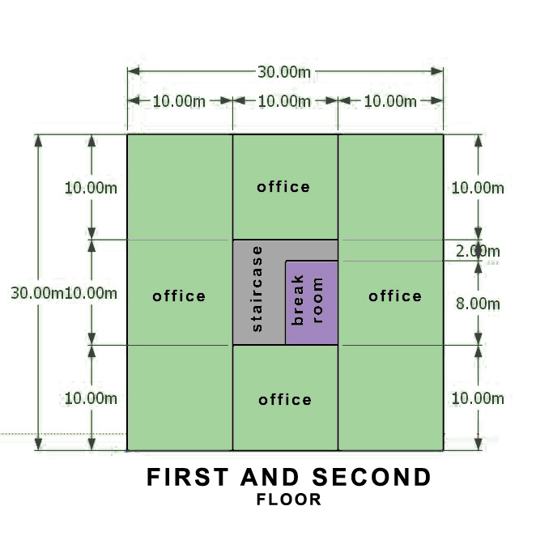
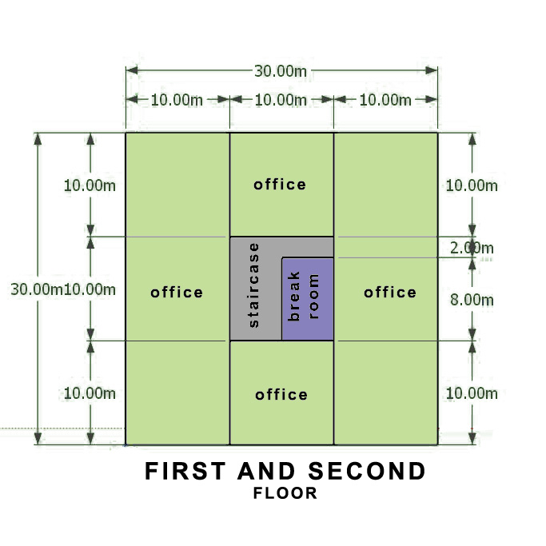
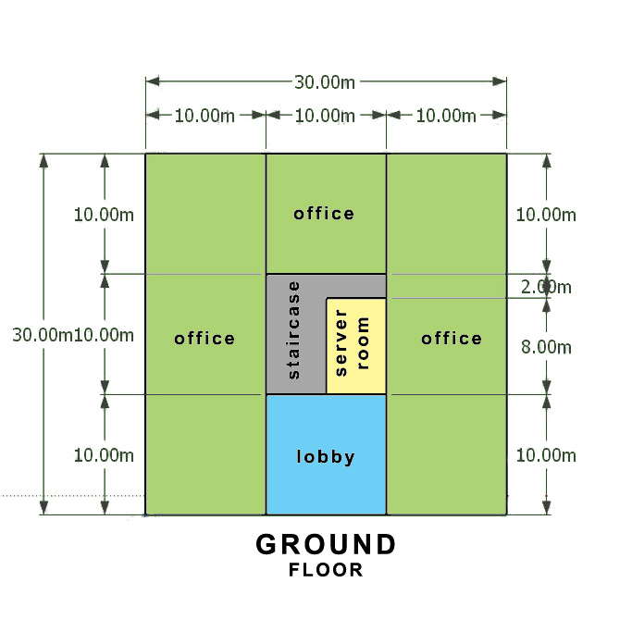
Spaces shown in the figure 1 are devided into different thermal zones, whic are defined as „spaces that use the same thermostat“. These spaces are colored differently as can be seen in figure 2.
In order to make a comparison, three distinct locations around the world were picked. The criteria for this choise is that every location has to be in a different construction zone.
Belgrade: Capital city of Serbia, sitting in a temperate zone of Balkan peninsula. The city has mildly cold winters and hot summers. Assigned construction zone is CZ 3.
Sidney: Largest city in Australia, also situated in a temperate climate but due to the proximity of the sea has much more humidity and heat. Construction zone CZ 2
Yakutsk: Russian city considered to be one of the coldest in the world. Largest city in continous permafrost. Assigned construction zone is CZ 8
FIGURE 2.

Slide 4
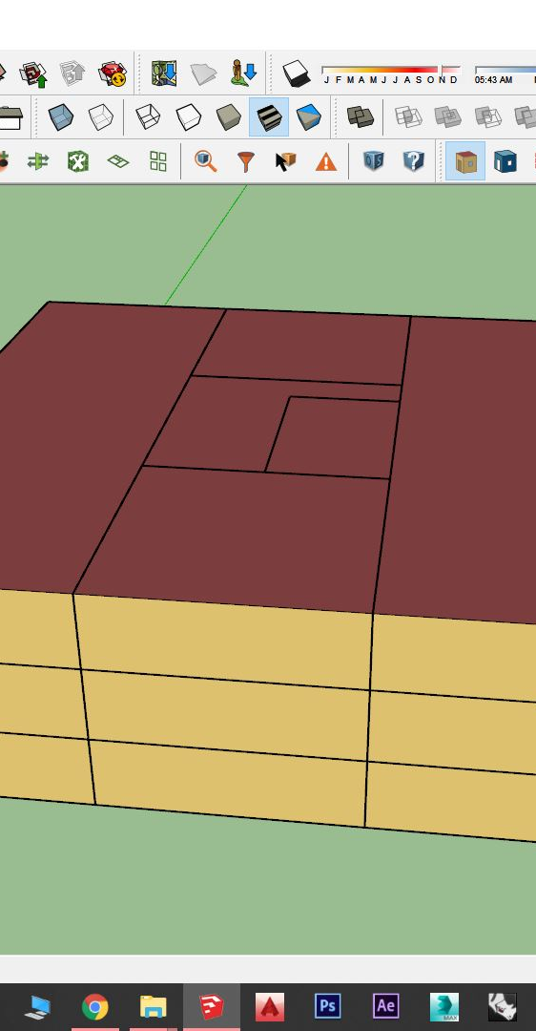
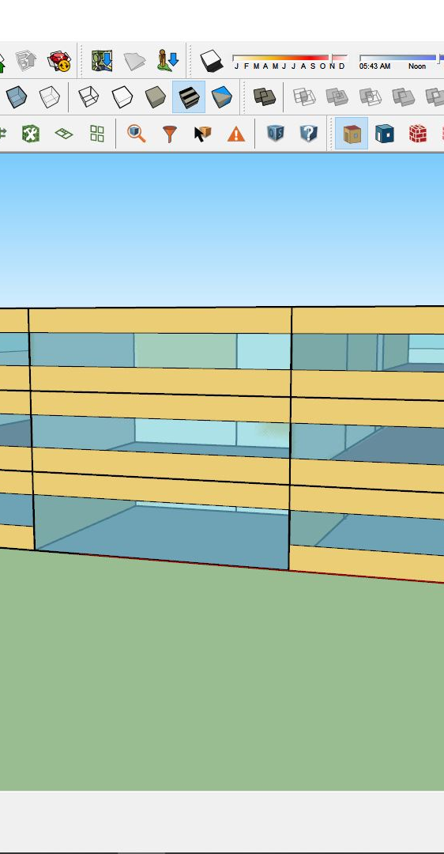
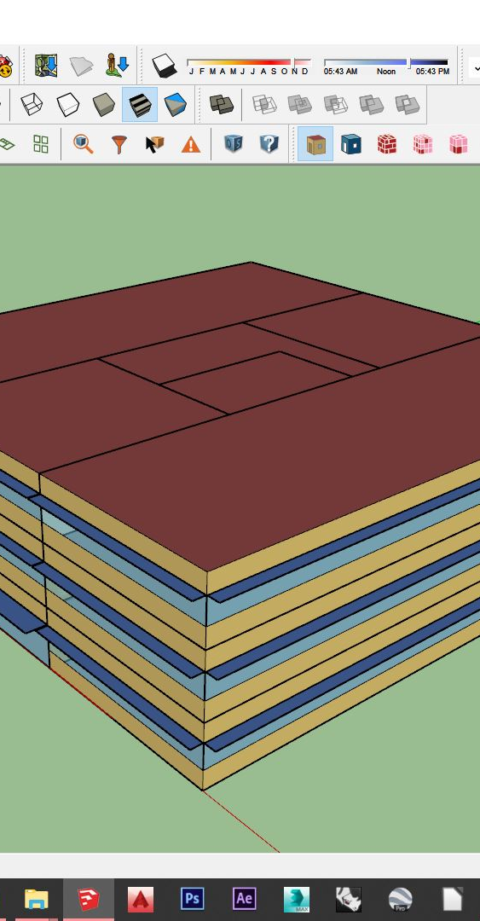
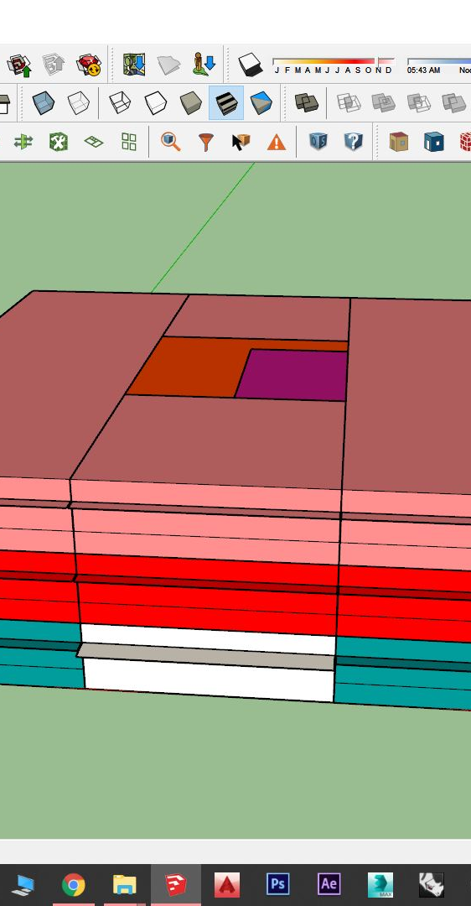
Work process:
Photo 1
Photo 2
Photo 3
Photo 4
In order to prepare the object for work in Open Studio, it had to be made in Google SketchUp 3D drawing software. First step was to draw the base and using OS extension rise it to three floors (photo 1), then the made object was given windows in cirtain ratio (photo 2) and overhangs on all sides exept north (photo 3). Finally the created zones were assigned specific attributes that describe the use of space and the primary construction zone for the object (photo 4).

Slide 5
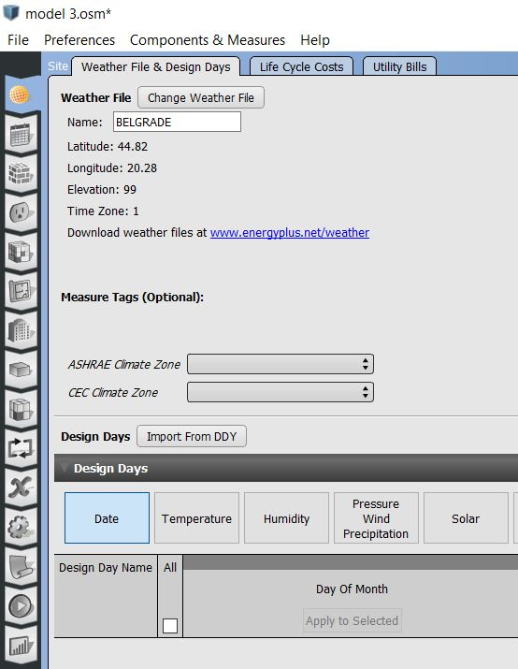
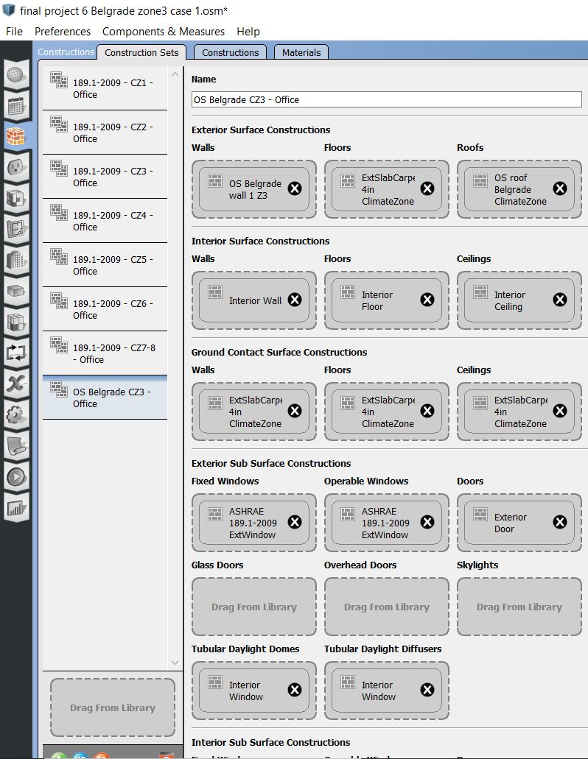
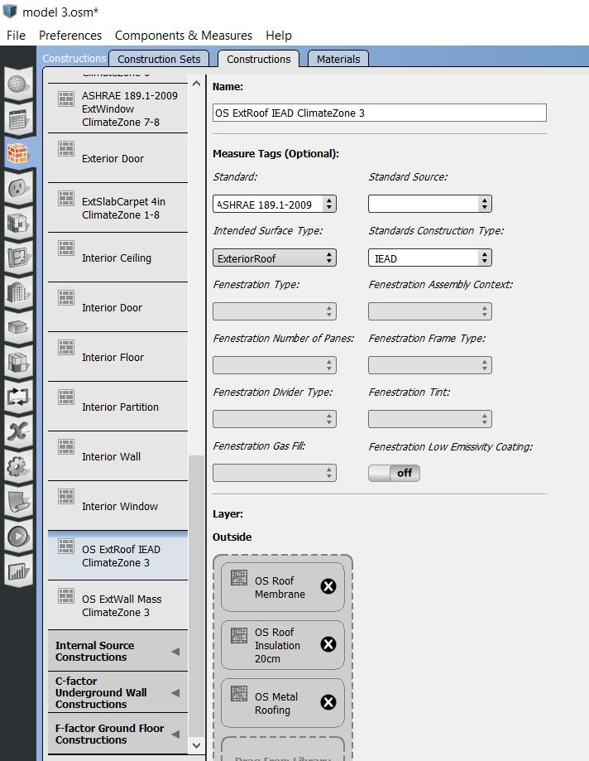
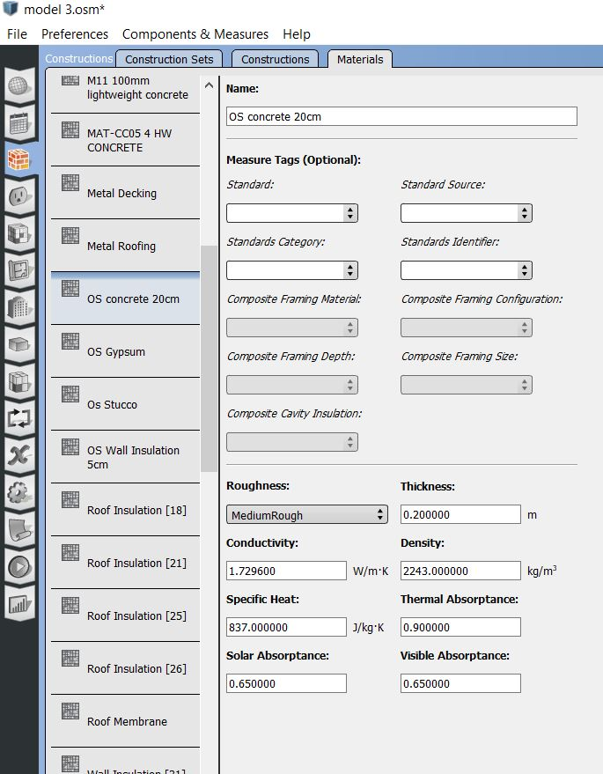
Work process:
After SketchUp, project is transfered to Open studio itself. In order to achieve the basic results with only construction changes there are few steps.
First the weather file for the location is needed (Belgrade in this case) (photo 1)
Secondly the materials need to be changed to something that suits more metric unit sistem. (photo 2)
From these materials new construcitons are created (walls and roof here). (photo 3)
Finally the constructions are added to designated sets for given construction zone and the simulation can run.(photo 4)
Photo 1
Photo 2
Photo 3
Photo 4

Slide 6
Building summary and results
Office building in Belgrade
Office building in Yakutsk
INFORMATION | VALUE | UNITS
Total built area | 2700.00 | m2
Net Site energy | 1378.96 | GJ
EUI (net site/built area) | 0.51072 | GJ/m2
INFORMATION | VALUE | UNITS
Total built area | 2700.00 | m2
Net Site energy | 2967.72 | GJ
EUI (net site/built area) | 0.90979 | GJ/m2
Wall construction:
Stucco 3cm
Wall insulation 5cm
HW concrete wall 20cm
Acoustic tile 2cm
Gypsum 2mm
END USE | CONSUMPTION [GJ]
Heating | 294.06
Cooling | 379.86
Interior Lighting | 327.09
Interior Equipment | 377.95
END USE | CONSUMPTION [GJ]
Heating | 2112.99
Cooling | 149.68
Interior Lighting | 327.09
Interior Equipment | 377.95
Office building in Sidney
END USE | CONSUMPTION [GJ]
Heating | 8.08
Cooling | 605.93
Interior Lighting | 327.09
Interior Equipment | 377.95
INFORMATION | VALUE | UNITS
Total built area | 2700.00 | m2
Net Site energy | 1319.05 | GJ
EUI (net site/built area) | 0.51520 | GJ/m2

Slide 7
Conclusion of part one:
In the first part of the analysis it has been concluded that the same object, designed for construction zone CZ3, works very efficiently in both Sidney and Belgrade. Sidney has the slight advantage because of the climate and there fore is more efficient, but at the same time requires double the energy for cooling, while it reqires almost none for heating. In Yakutsk however, this example is shown to be highly inefficient in terms of energy. Extremely cold temperatures and thin insulation of the wall mean that the building will need large ammounts of energy to maintain pleasant conditions inside. This ammount is almost 10 times more than Belgrade and 22 times more that Sidney require.
Second part of analysis:
For the second part of analysis the only location taken into consideration will be Belgrade. In this part efficiency of the construcion, mainly walls, within the same climate area will be tested. For the refference 3 wall will be analized: one without insulation, one with regular one-sided insulation and one with double sided insolation, ment for extremely cold climates.

Slide 8
Wall analysis results:
Belgrade, one-side insolated wall
Common parameters for building
END USE | CONSUMPTION [GJ]
Heating | 294.06
Cooling | 379.86
Interior Lighting | 327.09
Interior Equipment | 377.95
Wall layers:
R=475.84 m2*K/W
Stucco 3cm
Wall insulation 5cm
Concrete wall 20cm
Acoustic tile 2cm
Gypsum 2mm
INFORMATION | VALUE | UNITS
Total built area | 2700.00 | m2
Net Site energy | 1378.96 | GJ
EUI (net site/built area) | 0.51072 | GJ/m2
Belgrade, wall with no insolation
Common parameters for the site
END USE | CONSUMPTION [GJ]
Heating | 421.38
Cooling | 404.50
Interior Lighting | 327.09
Interior Equipment | 377.95
 | TOTAL USE [GJ]
Total site energy | 1378.96
Net site energy | 1378.96
Total source energy | 3696.40
Net source energy | 3696.30
R=363.58 m2*K/W
Stucco 3cm
Concrete wall 20cm
Acoustic tile 2cm
Gypsum 2mm
Belgrade, wall with double insolation
END USE | CONSUMPTION [GJ]
Heating | 263.80
Cooling | 378.62
Interior Lighting | 327.09
Interior Equipment | 377.95
R=493.91 m2*K/W
Stucco 3cm
Wall insulation 5cm
Concrete wall 20cm
Wall insulation 5cm
Acoustic tile 2cm
Gypsum 2mm

Slide 9
Wall analysis conclusion:
The results of the wall analysis show that removing a layer of insolation in the temperate climate, more preicisely in construction zone 3, effects the energy consumption negatively both in terms of heating and cooling. Using double-sided insolation however does not provide any signifficant benefits to the consumption in both cooling and heating and simply adds to the costs of construction.
Final conclusion:
This conducted two part analysis showed that there are two very important factors when designing the building for efficient energy consumption. First one being the location and construction zone that the object is in, and the secon one being the very construction of the exterior walls of the building. In order to achieve the propper ballance between the heating and cooling consumption it is important to respect the weather conditions of the location and, acording to them design the exterior walls before starting to work on HVAC sistems.

